Slide 1
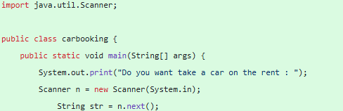
PROJECT ON CAR RENT
WE USE TOPIC IN THIS PROJECT WHICH ARE FOLLOWING :
User input – output :-
Syntax :- In Java, the primary way to obtain user input from the console is by utilizing the Scanner class, which is part of the java.util package.
import java.util.Scanner;
Create a Scanner object: Instantiate a Scanner object, typically linking it to System.in, which represents the standard input stream (console).
Scanner scanner = new Scanner(System.in);
2). Print Statements :-
Syntax :- This method prints the specified data to the console but does move the cursor to the next line
System.out.println() (Print Line)
This method prints the specified data to the console but does not move the cursor to the next line
System.out.print) (Print)

Slide 2
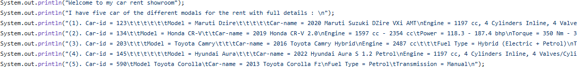
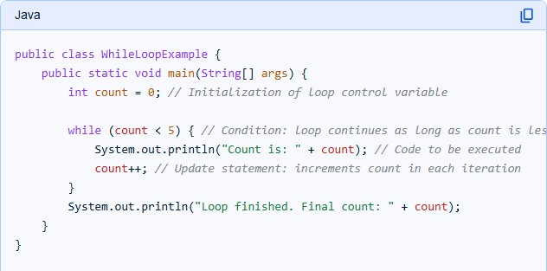
3). Apply while loop() Statement :-
Syntax :- while (condition) {
// Code to be executed repeatedly
// Update statements for loop control variables
}
Example :-

Slide 3
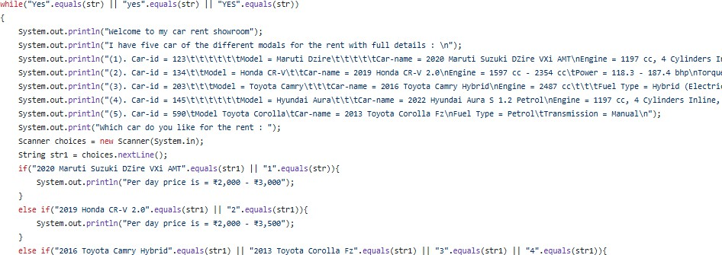

4). Use if - else statements : -
If statement Syntax :- If (condition)
{
//Statements to be executed
}
else –if statement Syntax :-
else if (condition2) {
// Code block to be executed if condition1 is false AND condition2 is true
}
else statement Syntax :-
else {
// Code block to be executed if the condition is false
}

Slide 4
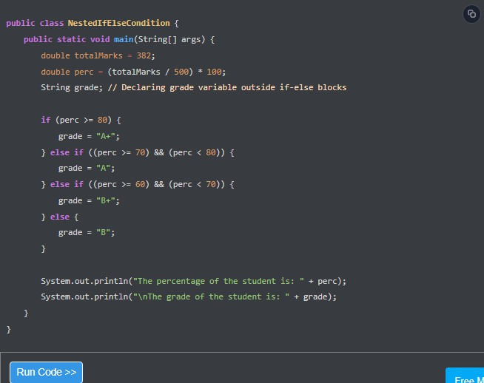
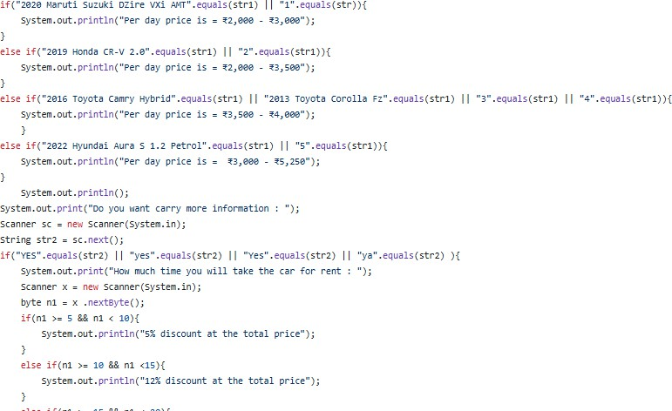
Example :-

Slide 5
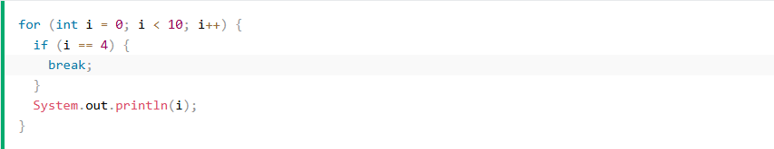
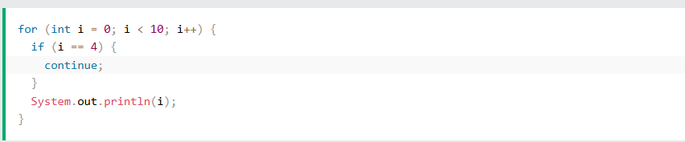
5). Use of break and continue statements :-
Syntax of break() statement :-
The break statement in Java is used to terminate the execution of a loop (e.g., for, while, do-while) .
When a break statement is encountered, control immediately transfers to the statement following the terminated construct.
Syntax of continue() statement :-
The continue statement in Java is used within loops (for, while, or do-while) to skip the current iteration and proceed to the next iteration of the loop.
Example :-

Slide 6
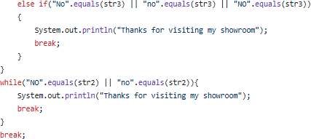


6). Use of File Handling :-
Syntax of File – Handling :-
File Handling is an integral part of any programming language as file handling enables us to store the output of any particular program in a file and allows us to perform certain operations on it.
In simple words, file handling means reading and writing data to a file.
CREATE A FILE()
WRITE ON A FILE()
READ FROM A FILE()
DELETE A FILE()

